Slide 1
PBIS
Positive Behavioral Intervention and Supports

Slide 2
Three Positives for the Week
Work at your table to come up with three positive things you have seen or heard about here at Bunger in the past week- be ready to share out in a few…

Slide 3
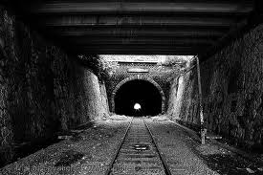
I CAN SEE THE LIGHT

Slide 4
Let’s freshen up!
Students receive verbal praise for following rules
Corrections are made by restating the rule/expectation and stating the appropriate replacement behavior
Maintains a four to one ratio of positive to negative statements

Slide 5
Quick Review: Re-phrase/Replace
“Hey, get over here!”
“You know better than that- slow down”
“Absolutely not, GET OUT!”
“Knock it off or you are going to wish you had”
“QUIET!”
“I have been dealing with this all year and I am sick of it”

Slide 6
SMART vocabulary-
SAFETY
MANNERS
ACHIEVEMENT
RESPONSIBILITY
TRUSTWORTHY
These five words and ideas have taken us a long way…
Use of this language is contagious

Slide 7
Management Reminders
Proximity- get up and move
Make assignments meaningful
Make time to call some parents
Register all communication on PLP
Follow the PBIS protocol, yes…even this late in the year

Slide 8
Effective Instruction Reminders
Content presented in an interesting manner
High level of engagement and activity
Instructional focus on student’s current and past skills
Give clear rubrics and expectations for assignments

Slide 9
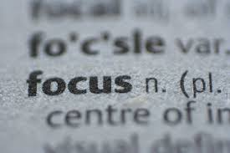
Suggestions for keeping focus

Slide 10
Looking Back
Share at your table one of your favorite memories or moments from this school year so far

Slide 11
SAS Survey
Go to the PBIS Assessment Website (I emailed everyone the link.)
Put in our School ID: 124128
Find the “Self Assessment Survey” and click on the arrow in the very last “Actions” column
Complete the survey
THANKS FOR ALL OF YOUR HARD WORK!!

